Slide 1

Molecular techniques RNA analysis
Justin Whalley

Slide 2
Utilizing an iPSC derived macrophage model to look at Ankylosing Spondylitis relevant enhancers: TNFRSF1A
Work from Dr Julie Osgood

Slide 3
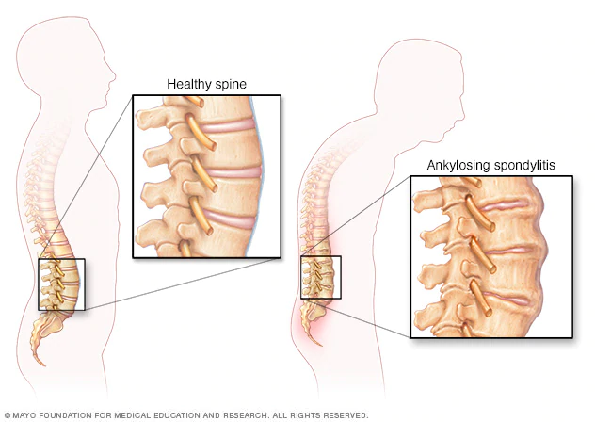
Ankylosing Spondylitis
Chronic inflammatory disorder
inflammation and osteoproliferation of the spine and sacroiliac joints
Age of onset 20-30
Affects men 2x more
Prevalence is 0.1-2%
Affects ~63000 in UK
Complex genetic disorder
Parent-child recurrence risk 7.9%
Heritability of 90%
HLA-B27
Multiple GWAS
48 loci currently associated
Treatments are often ineffective
Brown et al. Arthritis Rheum . 1997
Ellinghaus et al. Nat Genet. 2016
Linda et al. Rheumatology. 2014
Palla et al. Clin Exp Rheumatol. 2012
Pedersen et al. Scand J Rheumatol. 2008
Raychaudhuri & Deodhar . J Autoimmun. 2014
Notes:
Brown et al. Arthritis Rheum . 1997
Ellinghaus et al. Nat Genet. 2016
Linda et al. Rheumatology. 2014
Palla et al. Clin Exp Rheumatol. 2012
Pedersen et al. Scand J Rheumatol. 2008
Raychaudhuri & Deodhar . J Autoimmun. 2014

Slide 4
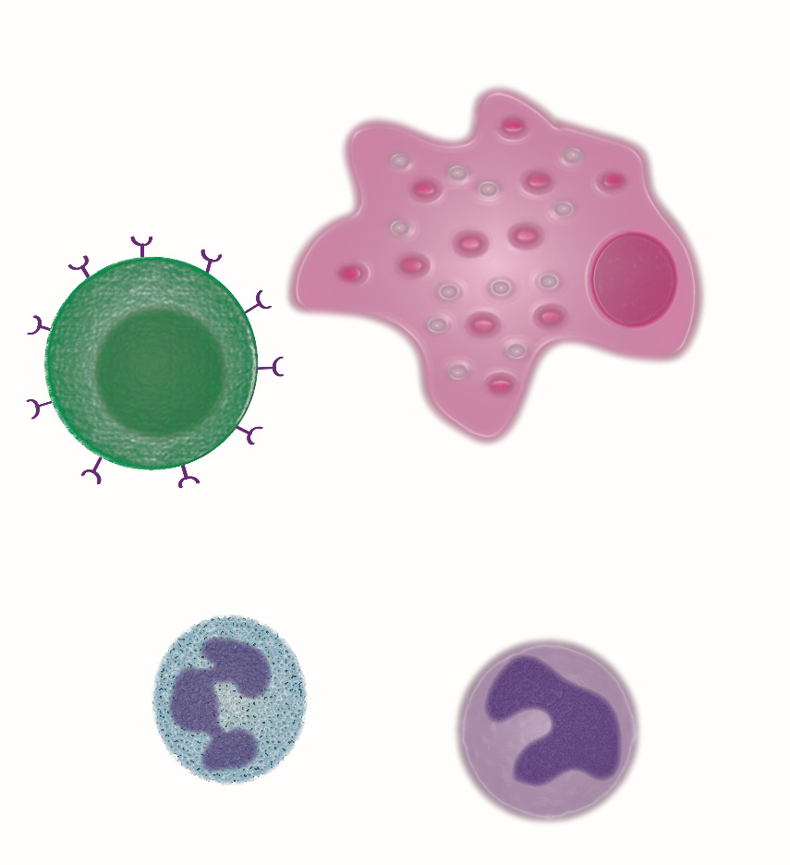

iPSC Derived Macrophages as a Model
Many immune cell types are implicated in disease
Unsure which is the most relevant
Strong evidence for monocytes/macrophages and T cells
Primary immune cells difficult to culture and edit
Limon-Camacho et al. J Rheumatol 2012
Wright et al. Ann Rheum Dis 2009
Zambrano-Zaragoza et al. Int J Inflam.2013
Notes:
Stem cells could be differentiated into other cell types down the line
Monocytes are the precursors for macrophages and dendritic cells, which are all involved in antigen presentation. Studies have found that monocytes in arthritis patients exhibit an upregulation of genes involved in essential inflammation pathways (101–103). One study used label-free quantitative expression profiling to examine protein expression (103). They noted upregulation in AS monocytes in proteins involved in leukocyte recruitment, and important signalling pathways such as, VEGF, JAK/STAT, and toll-like receptor (TLR). Moreover, there was shown to be an upregulation of genes in the ubiquitin proteasome pathway (UPP) in AS monocytes (103). This pathway is involved in the formation of peptides to be presented by HLA ClassI proteins, like HLA-B27.
One theory of AS pathogenesis, known as the arthritogenic
peptide hypothesis, relies on the involvement of CD8þT cells
[99, 100]. This hypothesis suggests that the self-peptides displayed
by HLA-B27 bear a resemblance to peptides produced by
foreign microbes and become the target of autoreactive CD8þT
cells. These cells then initiate an immune response and inflammation
ensues.
Moreover, it was found that CD4þT cells express
KIR3DL2, which is a receptor that recognizes homodimers
of HLA-B27 but does not recognize heterodimers of HLA-B27
The binding of KIR3DL2 to HLA-B27 homodimers could
trigger an immune response and lead to inflammation, and it is
also suggested that binding triggers Th17 responses
Monocytes in spondyloarthritis
patients exhibit an upregulation of genes involved in
essential inflammation pathways.

Slide 5
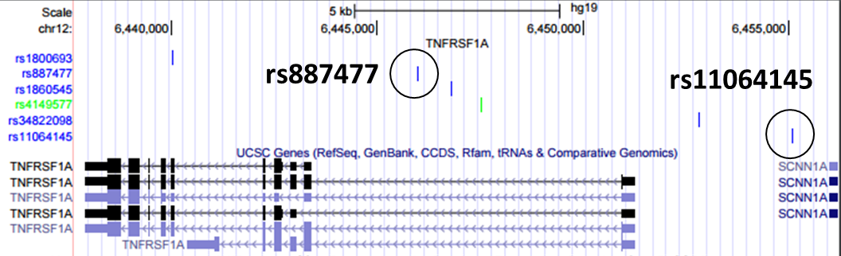
TNFRSF1A
Main TNF receptor
Fine mapped to 6 SNPs
rs887477 and rs11064145
In regions of open chromatin and predicted enhancers
KO TNFRSF1A, two enhancers
Notes:
Not experimentally validated

Slide 6
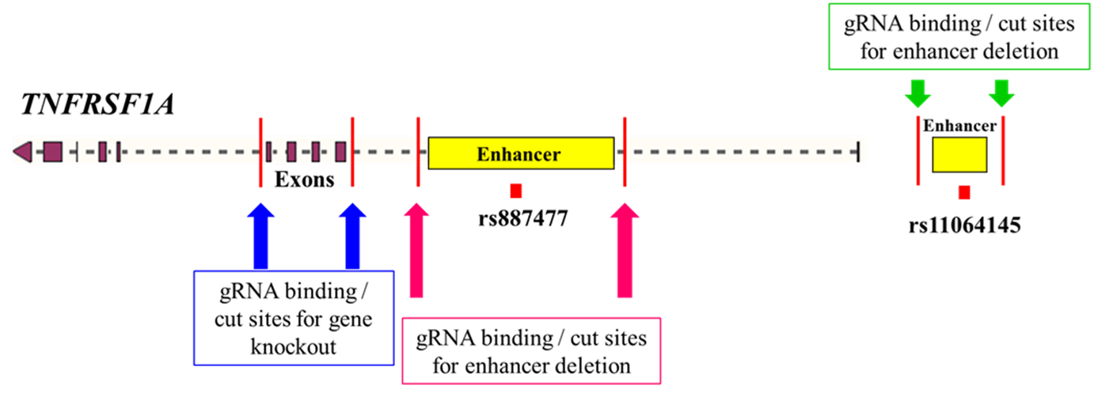
Designing guide RNAs: KO Strategy

Slide 7

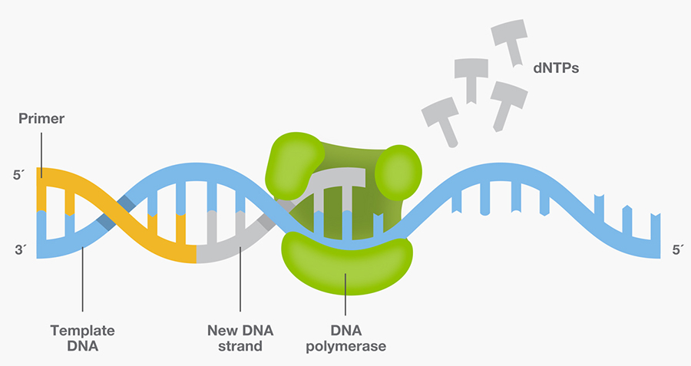
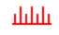
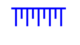

PCR amplification
DNA strand made of nucleotides
Primers (forward and reverse)
Taq DNA polymerase (enzyme)

Slide 9
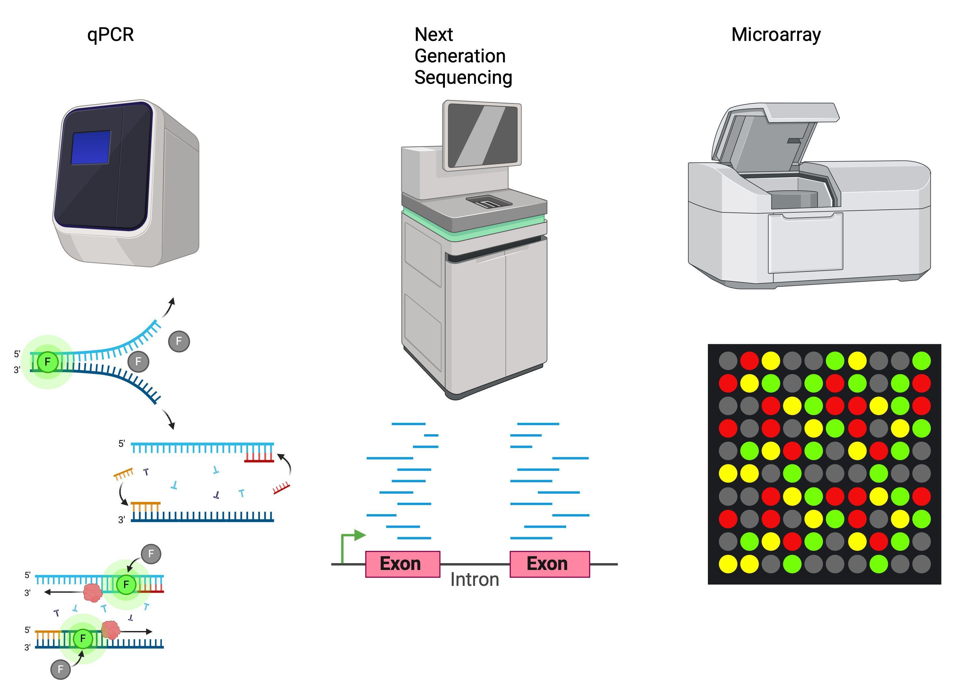
Measuring Gene expression

Slide 10
Measuring Gene expression
Feature | qPCR | RNA-seq (NGS) | Microarrays
Throughput | Low (single or few genes) | High (whole transcriptome) | High (thousands of genes)
Quantification | Absolute/Relative | Quantitative (read counts) | Semi-quantitative (intensity of fluorescence)
Sensitivity | Very high | High | Medium
Novel Gene Detection | No | Yes | No
Cost | Low for small-scale experiments | High | Medium
Typical Use Cases | Targeted gene studies | Global gene expression analysis | Mostly replaced by RNA-seq
Notes:
1. Quantitative PCR (qPCR)
qPCR, also known as real-time PCR, is a highly sensitive and specific method used to measure gene expression levels by quantifying the amount of a target nucleic acid (usually mRNA, converted into cDNA). It is a variation of PCR that allows real-time monitoring of the amplification process.
Key Steps:
RNA Isolation: Extract total RNA from the sample.
Reverse Transcription: Convert mRNA into complementary DNA (cDNA).
PCR Amplification: Use primers specific to the gene of interest and a fluorescent dye (e.g., SYBR Green or TaqMan probes) to amplify the cDNA and measure its quantity in real time.
Quantification: The fluorescent signal increases as the PCR product accumulates, and the cycle at which fluorescence reaches a threshold (Ct value) is used to calculate gene expression levels.
Key Features:
Sensitivity: Can detect very low levels of gene expression.
Specificity: Highly specific to the target gene due to the use of specific primers.
Quantitative: Provides precise quantification of gene expression levels, often normalized to housekeeping genes (e.g., GAPDH or β-actin).
Advantages:
High sensitivity and specificity.
Suitable for low-expression genes.
Relatively low cost for a small number of genes.
Limitations:
Limited throughput: Can only measure a few genes at a time.
Requires prior knowledge of the gene sequence for primer design.
Relative quantification depends on reference genes.
Common Use Cases:
Validation of gene expression changes found in broader studies (e.g., microarray or RNA-seq).
Measuring the expression of specific genes in targeted studies (e.g., biomarkers).
2. Next-Generation Sequencing (NGS) – RNA Sequencing (RNA-seq)
RNA-seq is a high-throughput sequencing method that provides a comprehensive view of the entire transcriptome. It allows for both qualitative and quantitative analysis of gene expression.
Key Steps:
RNA Isolation: Extract total RNA or enrich for mRNA (poly-A selection or ribosomal RNA depletion).
Library Preparation: Convert RNA into a library of cDNA fragments, add adapters, and prepare for sequencing.
Sequencing: Use an NGS platform (e.g., Illumina, PacBio) to sequence the cDNA fragments.
Data Analysis: Align the sequence reads to a reference genome or transcriptome, count reads mapped to each gene, and quantify gene expression levels.
Key Features:
Unbiased: Detects both known and novel transcripts, including splicing variants, non-coding RNAs, and previously unknown genes.
Quantitative: Expression levels are measured based on the number of reads mapped to each gene, reported as FPKM (Fragments Per Kilobase of transcript per Million mapped reads) or TPM (Transcripts Per Million).
Depth and Breadth: Provides information on a wide range of expression levels, from highly to lowly expressed genes.
Advantages:
Provides a complete view of the transcriptome.
High throughput, allowing analysis of thousands of genes simultaneously.
Can detect novel transcripts and alternative splicing events.
Can measure allele-specific expression and RNA editing.
Limitations:
Higher cost and more complex data analysis compared to qPCR and microarrays.
Requires significant computational resources for data analysis.
May require a high depth of sequencing for low-abundance transcripts.
Common Use Cases:
Global transcriptome profiling in various conditions (e.g., cancer studies, developmental biology).
Discovery of novel transcripts and alternative splicing events.
Differential gene expression analysis between conditions.
3. Microarrays
Microarrays are a hybridization-based technology used to measure the expression of thousands of genes simultaneously. They rely on the hybridization of cDNA from the sample to probes on a solid surface, which represent known genes or transcripts.
Key Steps:
RNA Isolation: Extract total RNA from the sample.
cDNA Synthesis and Labeling: Convert RNA into cDNA and label it with a fluorescent dye.
Hybridization: Hybridize the labeled cDNA to a microarray chip containing thousands of DNA probes.
Scanning and Analysis: Measure the fluorescence intensity at each probe location, which corresponds to the amount of hybridized cDNA and, thus, gene expression levels.
Key Features:
Targeted: Can only detect genes for which there are pre-designed probes on the array.
Quantitative: Measures gene expression based on the intensity of fluorescence.
Comparative: Often used to compare gene expression levels between two or more conditions (e.g., healthy vs diseased).
Advantages:
Can measure thousands of genes simultaneously in a single experiment.
More cost-effective for large-scale studies compared to RNA-seq.
Established technology with well-validated methods.
Limitations:
Requires prior knowledge of the gene sequence for probe design.
Limited to detecting only those genes represented on the array.
Less sensitive and accurate than RNA-seq, particularly for low-abundance genes.
Hybridization-based, which can lead to cross-hybridization and background noise.
Common Use Cases:
Gene expression profiling in disease vs normal tissue.
Functional genomics studies where large numbers of genes are measured.
Biomarker discovery for clinical diagnostics.

Slide 12

WHOLE GENOME gene expression
donor
genes
Non-treated, ‘naive’,
monocytes
Notes:
In this dataset we have:
228 donors, ~15000 gene expression values

Slide 13
WHOLE GENOME gene expression
donor
genes
Naive
IFNγ treated
monocytes
Notes:
Gene expression for the monocytes treated by inteferon-gamma – proteins that help regulated the immune system.

Slide 14
WHOLE GENOME gene expression
donor
genes
Naive
IFNγ
Lipopolysaccharide (LPS) treated
monocytes (2 hour wait)
Notes:
Major component of the outer wall of gram negative bacteria, which our body registers as a toxin and elicits a strong immune response.

Slide 15
donor
WHOLE GENOME gene expression
genes
Naive
IFNγ
LPS 2h
Lipopolysaccharides (LPS) treated
monocytes (24 hour wait)
15
Notes:
Also gene expression after 1 day of being treated.

Slide 16
WHOLE GENOME gene expression
donor
genes
Fairfax et al. Innate immune activity conditions the effect of regulatory variants upon monocyte
gene expression. Science, 2014.
Naive
IFNγ
Treatment
LPS 2h
LPS 24h
Notes:
So we have a dataset for 912 samples, gene expression data for ~15,000 genes.

Slide 17
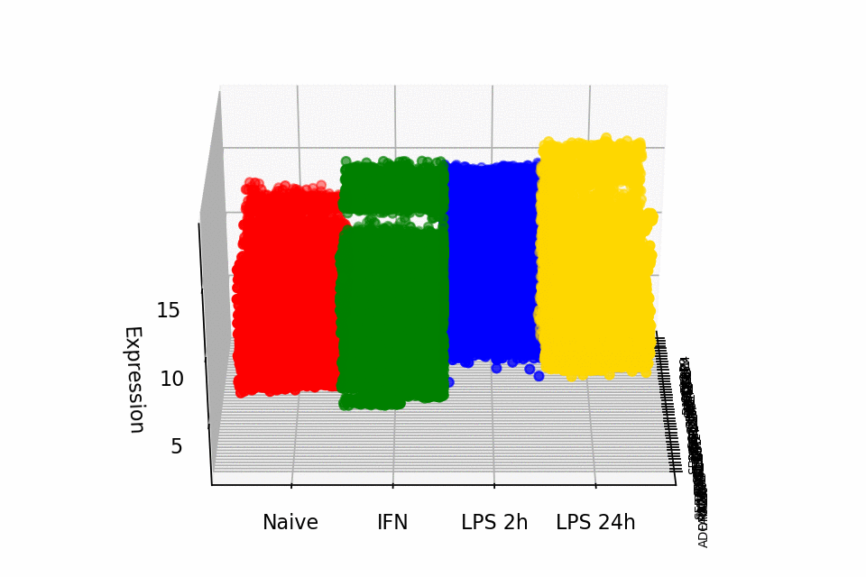
whole genome GENE expression
Notes:
No doubt there is high redundancy amongst the samples, so reducing them from ~15000 to a smaller number could be really helpful into interpreting the dataset (in this case for projecting the gene expression and genes into one value for each sample for each principal component).

Slide 19
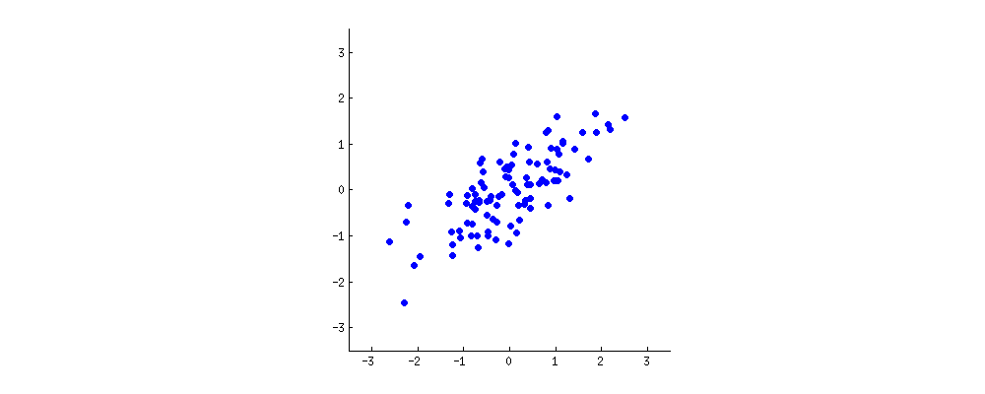
PCA: defining components
https://stats.stackexchange.com/questions/2691/making-sense-of-principal-component-analysis-eigenvectors-eigenvalues
Notes:
Looking at two characteristics of a our dataset (x and y). Want to reduce it from 2D to 1D.
A new property can be constructed by drawing a line through the centre of this cloud and projecting all points onto this line. This new property will be given by a linear combination w1x+w2y, where each line corresponds to some particular values of w1 and w2.

Slide 20

PCA: defining components
https://stats.stackexchange.com/questions/2691/making-sense-of-principal-component-analysis-eigenvectors-eigenvalues
Notes:
PCA will find the "best" line according to two different criteria of what is the "best". First, the variation of values along this line should be maximal. Pay attention to how the "spread" (we call it "variance") of the red dots changes while the line rotates; can you see when it reaches maximum? Second, if we reconstruct the original two characteristics (position of a blue dot) from the new one (position of a red dot), the reconstruction error will be given by the length of the connecting red line. Observe how the length of these red lines changes while the line rotates; can you see when the total length reaches minimum?

Slide 21
PCA on highly correlated data
Notes:
When we have a high correlation, reducing the dimensions makes sense (in this case the PCA component one explains a high percentage of variance of the dataset).

Slide 22
PCA on uncorrelated data
Notes:
However when we have low level of correlation, we are less successful in reducing the dimensions, in this case both components tend to explain the same amount of variance of the dataset.
We rarely would use PCA on a two dimensional dataset, lets look instead a gene expression experiment.

Slide 24
Single Cell Rna sequencing
Notes:
Looking at scRNA-seq from obese mouse tissue. Interesting in difference treatment with clodronate has.

Slide 25
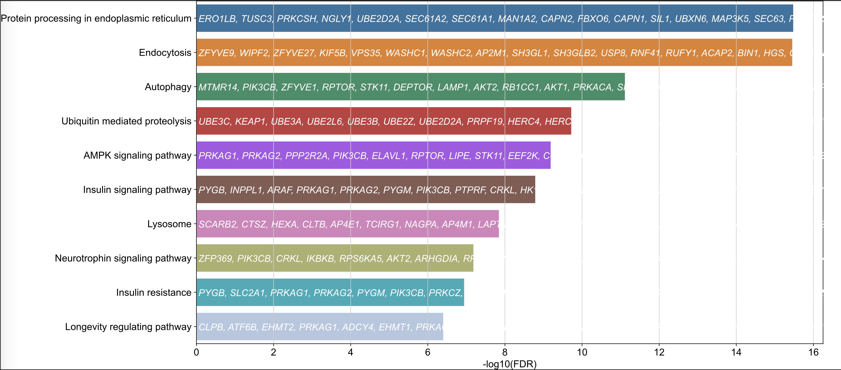
Single Cell Rna sequencing
Notes:
Looking at scRNA-seq from obese mouse tissue. Interesting in difference treatment with clodronate has.

